Slide 1
Query processing
Dr Manjiree Vyawahare

Slide 2
What is Normalization ?
Normalization is the process of organizing the data in the database.
Normalization is used to minimize the redundancy from a relation or set of relations.
It is also used to eliminate the undesirable characteristics like Insertion, Update and Deletion Anomalies.
Normalization divides the larger table into the smaller table and links them using relationship.
The normal form is used to reduce redundancy from the database table.
Notes:
https://www.javatpoint.com/dbms-third-normal-form

Slide 3
Types of Normal Forms There are the four types of normal forms:
Normal forms
BCNF
1NF
2NF
3NF

Slide 4
Normal Form | Description
1NF | A relation is in 1NF if it contains an atomic value. An atomic value is a value that cannot be divided.
2NF | A relation will be in 2NF if it is in 1NF and all non-key attributes are fully functional dependent on the primary key.
3NF | A relation will be in 3NF if it is in 2NF and no transition dependency exists.
4NF | A relation will be in 4NF if it is in Boyce Codd normal form and has no multi-valued dependency.
5NF | A relation is in 5NF if it is in 4NF and not contains any join dependency and joining should be lossless.

Slide 5
First Normal Form (1NF)
A relation will be 1NF if it contains an atomic value.
It states that an attribute of a table cannot hold multiple values. It must hold only single-valued attribute.
First normal form disallows the multi-valued attribute, composite attribute, and their combinations.
Example: Relation EMPLOYEE is not in 1NF because of multi-valued attribute EMP_PHONE.

Slide 6
What is a KEY?
A KEY is a value used to identify a record in a table uniquely.
A KEY could be a single column or combination of multiple columns
[Note: Columns in a table that are NOT used to identify a record uniquely are called non-key columns.]
A primary is a single column value used to identify a database record uniquely.
It has following attributes
A primary key cannot be NULL
A primary key value must be unique
The primary key values should rarely be changed
The primary key must be given a value when a new record is inserted.

Slide 7
What is Composite Key?
A composite key is a primary key composed of multiple columns used to identify a record uniquely
In our database, we have two people with the same name Saurabh, Nikhil but they live in different places and different surnames
Hence, we require both Fnm,mnm,lnm Name and Address to identify a record uniquely. That is a composite key.

Slide 8
Foreign Key
Foreign Key references the primary key of another Table. It helps connect the Tables
A foreign key can have a different name from its primary key
It ensures rows in one table have corresponding rows in another table
Unlike the Primary key, they do not have to be unique. Most often they aren't Foreign keys can be null even though primary keys can not

Slide 9
Primary key
Transaction
Bank master
Account num | Name | amount
1 | aniket | 5000
2 | shivani | 5000
3 | Divya | 5000
4 | Aadya | 5000
5 | Nikhil | 5000
6 | Saurabh | 5000
Account num [fk] | T_type | amount
2 | D | 3000
2 | W | 1000
6 | D | 3500
4 | D | 6000

Slide 10
Why do you need a foreign key?
Suppose, a novice inserts a record in Table B such as
You will only be able to insert values into your foreign key that exist in the unique key in the parent table. This helps in referential integrity.
The above problem can be overcome by declaring membership id from Table2 as foreign key of membership id from Table1
Now, if somebody tries to insert a value in the membership id field that does not exist in the parent table, an error will be shown!

Slide 11
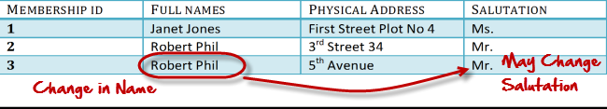
What are transitive functional dependencies?
A transitive functional dependency is when changing a non-key column, might cause any of the other non-key columns to change
Consider the table 1. Changing the non-key column Full Name may change Salutation.

Slide 12
Form which is a simple storage of data : called as database
Account Number [pk] | Name | Address | City | Phone number | Amount
1 | aniket | Abcd | NAGPUR | 455542 | 5000
2 | shivani | Efgh | AMRAVATI | 4445242 | 5000
3 | Divya | Hijk | AKOLA | 676575667 | 5000
4 | Aadya | Lmnop | WARDHA | 767557567 | 5000
5 | Nikhil | Ram nagar | CHANDRAPUR | 6576575767 | 5000
6 | Saurabh | Uvwx | NAGPUR | 567575675657 | 5000
7 | gargi | Abcd | AMRAVATI | 6576577 | 5000
8 | Nikhil | Efgh | AKOLA | 5635353 | 5000
9 | Sheetal | Hijk | WARDHA | 575756756 | 5000
10 | Shubh | Lmnop | CHANDRAPUR | 23424234 | 5000
 | Monika | Qrst | DELHI | 657567567567 | 5000
 | abhay | Uvwx | BHOPAL | 686786 | 5000

Slide 13
Name | Address | City | Amount | TRANSACTION | T_DATE
aniket | Abcd | NAGPUR | 5000 | 4000 | 26/02/21
shivani | Efgh | AMRAVATI | 5000 | 5000 | 26/02/21
Divya | Hijk | AKOLA | 5000
Aadya | Lmnop | WARDHA | 5000
Nikhil | Qrst | CHANDRAPUR | 5000 | 5000 | 27/02/21
Saurabh | Uvwx | NAGPUR | 5000 | 4000 | 27/02/21
Nikhil | Efgh | AKOLA | 5000 | 20000 | 27/02/21
Saurabh | Uvwx | NAGPUR | 5000
gargi | Abcd | AMRAVATI | 5000
Nikhil | Efgh | AKOLA | 5000
Sheetal | Hijk | WARDHA | 5000
Shubh | Lmnop | CHANDRAPUR | 5000
Monika | Qrst | DELHI | 5000
Abhay | Uvwx | BHOPAL | 5000

Slide 14
EMPLOYEE table:
EMP_ID | EMP_NAME | EMP_PHONE | EMP_STATE
14 | Amit | 7272826385, 9064738238 | Maharashtra
20 | Sumit | 8574783832 | Bihar
12 | Radha | 7390372389, 8589830302 | Punjab
In this table the phone numbers of emp are two. If we try to search second num we never got it unless n until we use some special feature of search
The decomposition of the EMPLOYEE table into 1NF has been shown below:
EMP_ID | EMP_NAME | EMP_PHONE | EMP_STATE
14 | Amit | 7272826385 | Maharashtra
14 | Amit | 9064738238 | Maharashtra
20 | Sumit | 8574783832 | Bihar
12 | Radha | 7390372389 | Punjab
12 | Radha | 8589830302 | Punjab

Slide 15
Second Normal Form (2NF)
In the 2NF, relational must be in 1NF.
In the second normal form, all non-key attributes are fully functional dependent on the primary key
Example: Let's assume, a school can store the data of teachers and the subjects they teach. In a school, a teacher can teach more than one subject.

Slide 16
TEACHER table
TEACHER_ID | SUBJECT | TEACHER_AGE
25 | Chemistry | 30
25 | Biology | 30
47 | English | 35
83 | Math | 38
83 | Computer | 38

Slide 17
EMP_ID | EMP_NAME | EMP_PHONE | EMP_STATE
14 | Amit | 7272826385 | Maharashtra
14 | Amit | 9064738238 | Maharashtra
20 | Sumit | 8574783832 | Bihar
12 | Radha | 7390372389 | Punjab
12 | Radha | 8589830302 | Punjab
EMP_ID | EMP_NAME | EMP_STATE
14 | Amit | Maha
20 | Sumit | Bihar
12 | Radha | Punjab
EMP_ID | EMP_PHONE
14 | 7272826385
14 | 9064738238
20 | 8574783832
12 | 7390372389
12 | 8589830302

Slide 18
In the given table, non-prime attribute TEACHER_AGE is dependent on TEACHER_ID which is a proper subset of a candidate key. That's why it violates the rule for 2NF.
To convert the given table into 2NF, we decompose it into two tables:

Slide 19
TEACHER_DETAIL table:
TEACHER_SUBJECT table:
TEACHER_ID | SUBJECT
25 | Chemistry
25 | Biology
47 | English
83 | Math
83 | Computer
TEACHER_ID | TEACHER_AGE
25 | 30
47 | 35
83 | 38

Slide 20
Third Normal Form (3NF)
A relation will be in 3NF if it is in 2NF and not contain any transitive partial dependency.
3NF is used to reduce the data duplication. It is also used to achieve the data integrity.
If there is no transitive dependency for non-prime attributes, then the relation must be in third normal form.
A relation is in third normal form if it holds at least one of the following conditions for every non- rivial function dependency X → Y.
X is a super key.
Y is a prime attribute, i.e., each element of Y is part of some candidate key.

Slide 21
Employee table
EMP_ID | EMP_NAME | CITY
222 | Saurabh | NAGPUR
333 | Nikhil | AKOLA
444 | Aadya | WARDHA
555 | Monika | GONDIA
666 | Payal | NAGPUR
Super key in the table above:
{EMP_ID}, {EMP_ID, EMP_NAME}, {EMP_ID, EMP_NAME, CITY}....so on
Candidate key: {EMP_ID}
Non-prime attributes: In the given table, all attributes except EMP_ID are non-prime.

Slide 22
EMPLOYEE_DETAIL table:
EMP_ID | EMP_NAME | POSTAL ADDRESS | PHONE | CITY | EMP_ZIP
222 | Saurabh | TERTRT | 123355554 | NAGPUR | 440025
333 | Nikhil | FGD | 34343433 | AKOLA | 440010
444 | Aadya | GFD | 3242424 | WARDHA | 440021
555 | Monika | GDG | 3343244 | CHANDRAPUR | 440035
666 | Payal | G | 4323424 | NAGPUR | 440055
Here, POSTAL ADDRES & EMP_CITY dependent on EMP_ZIP and EMP_ZIP dependent on EMP_ID.
The non-prime attributes (EMP_STATE, EMP_CITY) transitively dependent on super key(EMP_ID). It violates the rule of third normal form.
That's why we need to move the EMP_CITY and EMP_STATE to the new <EMPLOYEE_ZIP> table, with EMP_ZIP as a Primary key.

Slide 23
Boyce Codd normal form (BCNF)
BCNF is the advance version of 3NF. It is stricter than 3NF.
A table is in BCNF if every functional dependency X → Y, X is the super key of the table.
For BCNF, the table should be in 3NF, and for every FD, LHS is super key.

Slide 24
EMPLOYEE table:
EMP_ID | EMP_COUNTRY | EMP_DEPT | DEPT_TYPE | EMP_DEPT_NO
264 | India | Designing | D394 | 283
264 | India | Testing | D394 | 300
364 | UK | Stores | D283 | 232
364 | UK | Developing | D283 | 549
Example: Let's assume there is a company where employees work in more than one department

Slide 25
In the above table Functional dependencies are as follows:
EMP_ID → EMP_COUNTRY
EMP_DEPT → {DEPT_TYPE, EMP_DEPT_NO}
Candidate key: {EMP-ID, EMP-DEPT}
The table is not in BCNF because neither EMP_DEPT nor EMP_ID alone are keys.
To convert the given table into BCNF, we decompose it into three tables:
EMP_COUNTRY table:

Slide 26
EMP_DEPT table:
EMP_ID | EMP_COUNTRY
264 | India
264 | India
EMP_DEPT | DEPT_TYPE | EMP_DEPT_NO
Designing | D394 | 283
Testing | D394 | 300
Stores | D283 | 232
Developing | D283 | 549

Slide 27
EMP_DEPT_MAPPING table
EMP_ID | EMP_DEPT
D394 | 283
D394 | 300
D283 | 232
D283 | 549

Slide 28
Functional dependencies
EMP_ID → EMP_COUNTRY
EMP_DEPT → {DEPT_TYPE, EMP_DEPT_NO}
Candidate keys:
For the first table: EMP_ID For the second table: EMP_DEPT For the third table: {EMP_ID, EMP_DEPT}
Now, this is in BCNF because left side part of both the functional dependencies is a key.

Slide 29
Fourth normal form (4NF
A relation will be in 4NF if it is in Boyce Codd normal form and has no multi-valued dependency.
For a dependency A → B, if for a single value of A, multiple values of B exists, then the relation will be a multi-valued dependency.

Slide 30
student
STU_ID | COURSE | HOBBY
21 | Computer | Dancing
21 | Math | Singing
34 | Chemistry | Dancing
74 | Biology | Cricket
59 | Physics | Hockey
The given STUDENT table is in 3NF, but the COURSE and HOBBY are two independent entity. Hence, there is no relationship between COURSE and HOBBY. In the STUDENT relation, a student with STU_ID, 21 contains two courses, Computer and Math and two hobbies, Dancing and Singing. So there is a Multi-valued dependency on STU_ID, which leads to unnecessary repetition of data.
So to make the above table into 4NF, we can decompose it into two tables:

Slide 31
STU_ID | COURSE
21 | Computer
21 | Math
34 | Chemistry
74 | Biology
59 | Physics
STUDENT_COURSE
STUDENT_HOBBY
STU_ID | HOBBY
21 | Dancing
21 | Singing
34 | Dancing
74 | Cricket
59 | Hockey

Slide 32
Fifth normal form (5NF)
A relation is in 5NF if it is in 4NF and not contains any join dependency and joining should be lossless.
5NF is satisfied when all the tables are broken into as many tables as possible in order to avoid redundancy.
5NF is also known as Project-join normal form (PJ/NF).

Slide 33
SUBJECT | LECTURER | SEMESTER
Computer | Anshika | Semester 1
Computer | John | Semester 1
Math | John | Semester 1
Math | Akash | Semester 2
Chemistry | Praveen | Semester 1
In the above table, John takes both Computer and Math class for Semester 1 but he doesn't take Math class for Semester 2. In this case, combination of all these fields required to identify a valid data.
Suppose we add a new Semester as Semester 3 but do not know about the subject and who will be taking that subject so we leave Lecturer and Subject as NULL. But all three columns together acts as a primary key, so we can't leave other two columns blank.
So to make the above table into 5NF, we can decompose it into three relations P1, P2 & P3:

Slide 34
p1
SEMESTER | SUBJECT
Semester 1 | Computer
Semester 1 | Math
Semester 1 | Chemistry
Semester 2 | Math

Slide 35
p2
SUBJECT | LECTURER
Computer | Anshika
Computer | John
Math | John
Math | Akash
Chemistry | Praveen

Slide 36
p3
SEMSTER | LECTURER
Semester 1 | Anshika
Semester 1 | John
Semester 1 | John
Semester 2 | Akash
Semester 1 | Praveen

Slide 37
Acc_no | Name | Amount
101 | Saurabh | 100
1022 | Aadya | 200
09 | Sayli | 300
1024 | Nikhil | 400
105 | Payal | 500
1 | Amit | 632
70 | Sumit | 963
101 | Radha | 4569
101 | gargi
TYPE | Amt
D | 500
D | 500
W | 200
W | 200
D | 500
W | 200
D | 500
LOAN_CODE | Loan_Amt
1 | 10 LAKH
2 | 12 LAKH
3 | 15 LAKH
AMOUNT_PAID | MONTH
1 LAKH | JAN
10,000 | JAN
30,000 | FEB
25,000 | FEB
35,000 | MARCH
10000 | APRIL

Slide 38
Acc_no | Name | Amount | TYPE | Amt | LOAN_CODE | Loan_Amt | AMOUNT_PAID | MONTH
101 | Saurabh | 100 | D | 500 | 1 | 10 LAKH | 1 LAKH | JAN
1022 | Aadya | 200 | D | 500 | 2 | 12 LAKH | 10,000 | JAN
09 | Sayli | 300 | W | 200 | 3 | 15 LAKH | 30,000 | FEB
1024 | Nikhil | 400 | W | 200 |  |  | 25,000 | FEB
105 | Payal | 500 | D | 500 |  |  | 35,000 | MARCH
1 | Amit | 632 | W | 200 |  |  | 10000 | APRIL
70 | Sumit | 963 | D | 500
101 | Radha | 4569
101 | gargi

Slide 39
Bank database without normalization
Acc_no | Name | Amount | TYPE | Amt | LOAN_CODE | Loan_Amt | AMOUNT_PAID | MONTH
101 | Saurabh | 100 | D | 500 | 1 | 10 LAKH | 1 LAKH | JAN
1022 | Aadya | 200 | D | 500 | 2 | 12 LAKH | 10,000 | JAN
09 | Sayli | 300 | W | 200 | 3 | 15 LAKH | 30,000 | FEB
1024 | Nikhil | 400 | W | 200 |  |  | 25,000 | FEB
105 | Payal | 500 | D | 500 |  |  | 35,000 | MARCH
1 | Amit | 632 | W | 200 |  |  | 10000 | APRIL
70 | Sumit | 963 | D | 500
101 | Radha | 4569
101 | gargi |  | D | 456
2345 | saurabh

Slide 40
Example of bank
TRANSACTION
BANK_MASTER
Acc_no [FK] | TYPE | Amt
102 | D | 500
103 | D | 500
102 | W | 200
101 | D | 500
101 | W | 200
LOAN_PAID
Acc_no [PK] | Name | Amount
101 | Saurabh | 100
102 | Aadya | 500
103 | Sayli | 300
104 | Nikhil | 400
105 | Payal | 500
LOAN_CODE | AMOUNT_PAID | MONTH
1 | 1 LAKH | JAN
2 | 10,000 | JAN
1 | 30,000 | FEB
2 | 25,000 | FEB
1 | 35,000 | MARCH
1 | 10000 | APRIL
LOAN_MASTER
LOAN_CODE [PK] | Acc_no [FK] | Loan_Amt
1 | 102 | 10 LAKH
2 | 104 | 12 LAKH
3 | 105 | 15 LAKH

Slide 41
Relational Decomposition
When a relation in the relational model is not in appropriate normal form then the decomposition of a relation is required.
In a database, it breaks the table into multiple tables.
If the relation has no proper decomposition, then it may lead to problems like loss of information.
Decomposition is used to eliminate some of the problems of bad design like anomalies, inconsistencies, and redundancy.

Slide 42
Types of Decomposition
Lossless Decomposition
Dependency Preserving

Slide 43
Lossless Decomposition
If the information is not lost from the relation that is decomposed, then the decomposition will be lossless.
The lossless decomposition guarantees that the join of relations will result in the same relation as it was decomposed.
The relation is said to be lossless decomposition if natural joins of all the decomposition give the original relation.

Slide 44
EMPLOYEE_DEPARTMENT table:
The above relation is decomposed into two relations EMPLOYEE and DEPARTMENT
EMP_ID | EMP_NAME | EMP_AGE | EMP_CITY | DEPT_ID | DEPT_NAME
22 | DIVYA | 28 | Mumbai | 827 | Sales
33 | AlMA | 25 | Delhi | 438 | Marketing
46 | SAURABH | 30 | Bangalore | 869 | Finance
52 | KOMAL | 36 | Mumbai | 575 | Production
60 | JOY | 40 | Noida | 678 | Testing

Slide 45
EMPLOYEE table:
EMP_ID | EMP_NAME | EMP_AGE | EMP_CITY
22 | DIVYA | 28 | Mumbai
33 | AlMA | 25 | Delhi
46 | SAURABH | 30 | Bangalore
52 | KOMAL | 36 | Mumbai
60 | JOY | 40 | Noida

Slide 46
DEPARTMENT table
Now, when these two relations are joined on the common column "EMP_ID", then the resultant relation will look like:
Employee ⋈ Department
DEPT_ID | EMP_ID | DEPT_NAME
827 | 22 | Sales
438 | 33 | Marketing
869 | 46 | Finance
575 | 52 | Production
678 | 60 | Testing

Slide 47
Hence, the decomposition is Lossless join decomposition.
EMP_ID | EMP_NAME | EMP_AGE | EMP_CITY | DEPT_ID | DEPT_NAME
22 | DIVYA | 28 | Mumbai | 827 | Sales
33 | AlMA | 25 | Delhi | 438 | Marketing
46 | SAURABH | 30 | Bangalore | 869 | Finance
52 | KOMAL | 36 | Mumbai | 575 | Production
60 | JOY | 40 | Noida | 678 | Testing

Slide 48
Dependency Preserving
It is an important constraint of the database.
In the dependency preservation, at least one decomposed table must satisfy every dependency.
If a relation R is decomposed into relation R1 and R2, then the dependencies of R either must be a part of R1 or R2 or must be derivable from the combination of functional dependencies of R1 and R2.
For example, suppose there is a relation R (A, B, C, D) with functional dependency set (A->BC). The relational R is decomposed into R1(ABC) and R2(AD) which is dependency preserving because FD A->BC is a part of relation R1(ABC).

Slide 49
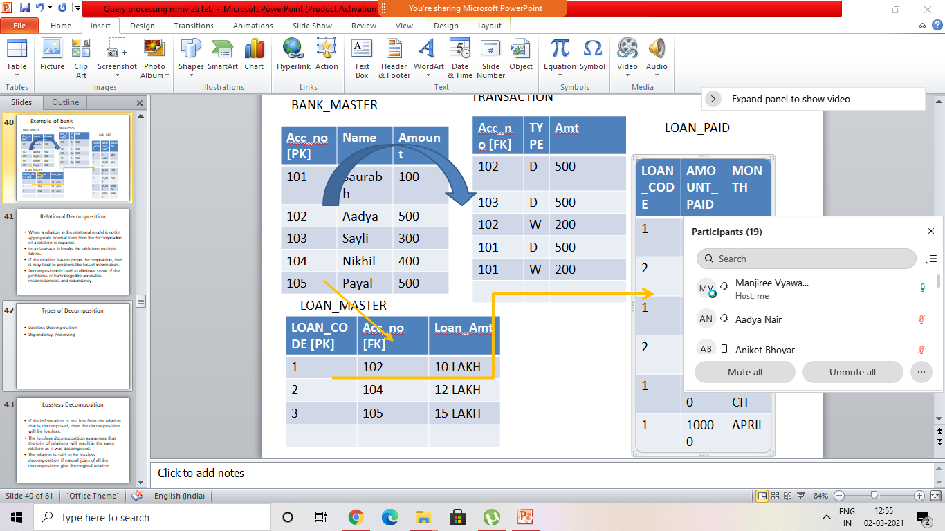
Todays lect 19 stud present 2/03/21

Slide 50
Query means what?
A query is a request for data or information from a database table or combination of tables. ... Using SQL, SQL is the most well-known and widely-used query language, is familiar to most database administrators (DBA)
SQL stands for Structured Query Language.
SQL lets you access and manipulate databases.
SQL became a standard of the American National Standards Institute (ANSI) in 1986, and of the International Organization for Standardization (ISO) in 1987.
A query is a question, often expressed in a formal way.
A database query can be either a select query or an action query.
A select query is a data retrieval query,
while an action query asks for additional operations on the data,
such as insertion, updating or deletion.

Slide 51
Query language
Query languages are used to make queries in a database, and Microsoft Structured Query Language (SQL) is the standard. Under the SQL query umbrella, there are several extensions of the language, including MySQL, Oracle SQL Query languages for other types of databases, such as graph databases.
Queries can accomplish a few different tasks.
Primarily, queries are used to find specific data by filtering specific criteria.
Queries can also calculate or summarize data, as well as automate data management tasks.
Other queries include parameter, totals, crosstab, make table, append, update and delete.
For example, a parameter query runs variations of a particular query, which prompts a user to insert a field value, and then it uses that value to create the criteria,
while totals queries allow users to group and summarize data.
An example of SQL query
In a relational database, which contains records or rows of information, the SQL SELECT statement query allows the user to choose data and return it from the database to an application.
The resulting query is stored in a result-table, which is called the result-set.
The SELECT statement can be broken down into other categories, such as FROM, WHERE and ORDER BY.
The SQL SELECT query also can group and aggregate data, such as summarize or analyze.

Slide 52
Web search query
The text typed into search engines, such as Bing, Google or Yahoo, is called a query.
Search-engine queries provide information that is much different from SQL languages because they don't require keyword or positional parameters.
A search-engine query is a request for information on a particular topic, and the request is made once a user selects 'Enter.'
Once the request is made, the search engine uses an algorithm to determine the best results, which are sorted based on significance according to the search engine -- details of which are not revealed publicly.
Types of search queries include navigational, informational and transactional.
Navigational searches are intended to find a particular website, such as YAHOO.com;
informational searches are designed to cover a broad topic, such a comparison between a new iPhone and Android device; and transactional searches seek to complete a transaction, such as the purchase of a new sweater on Amazon.com

Slide 53
Query Optimization.
we discuss the techniques used internally by a DBMS to process, optimize, and execute high-level queries.
A query expressed in a high-level query language such as SQL must first be scanned, parsed, and validated.
The scanner identifies the query tokens—
such as SQL keywords, attribute names, and relation names—that appear in the text of the query,
whereas the parser checks the query syntax to determine whether it is formulated according to the syntax rules (rules of grammar) of the query language.
The query must also be validated by checking that all attribute and relation names are valid and semantically meaningful names in the schema of the particular database being queried.

Slide 54
Def:- Query tree & Query graph & Query optimization
An internal representation of the query is then created, usually as a tree data structure called a query tree.
It is also possible to represent the query using a graph data structure called a query graph.
The DBMS must then devise an execution strategy or query plan for retrieving the results of the query from the database files.
A query typically has many possible execution strategies, and the process of choosing a suitable one for processing a query is known as query optimization

Slide 55
Steps of processing a high-level query.
The different steps of processing a high-level query.
The query optimizer module has the task of producing a good execution plan, and the code
The runtime database processor has the task of running (executing) the query code,
whether in compiled or interpreted mode, to produce the query result.
If a runtime error results, an error message is generated by the runtime database processor.

Slide 56
Query in a high-level language Figure 19.1 Typical steps when processing a high-level
Query in a high-level language
Parsing means analysing syntactically (syntax)
Scanning, parsing, and validating
Immediate form of query
Query optimizer
Execution plan
Code can be:
Executed directly (interpreted mode)
Stored and executed later whenever
needed (compiled mode)
Query code generator
Code to execute the query
Runtime database processor
Result of query

Slide 57
Query Processing in DBMS
Query Processing is the activity performed in extracting data from the database. In query processing, it takes various steps for fetching the data from the database. The steps involved are:
Parsing and translation
Optimization
Evaluation

Slide 58
The query processing works in the following way:
Parsing and Translation
As query processing includes certain activities for data retrieval.
Initially, the given user queries get translated in high-level database languages such as SQL.
It gets translated into expressions that can be further used at the physical level of the file system.
After this, the actual evaluation of the queries and a variety of query -optimizing transformations and takes place.
Thus before processing a query, a computer system needs to translate the query into a human-readable and understandable language.

Slide 59
Consequently, SQL or Structured Query Language is the best suitable choice for humans. But, it is not perfectly suitable for the internal representation of the query to the system.
Relational algebra is well suited for the internal representation of a query. The translation process in query processing is similar to the parser of a query.
When a user executes any query, for generating the internal form of the query, the parser in the system checks the syntax of the query, verifies the name of the relation in the database, the tuple, and finally the required attribute value.
The parser creates a tree of the query, known as 'parse-tree.' Further, translate it into the form of relational algebra. With this, it evenly replaces all the use of the views when used in the query.
Thus, we can understand the working of a query processing in the below-described diagram:

Slide 60
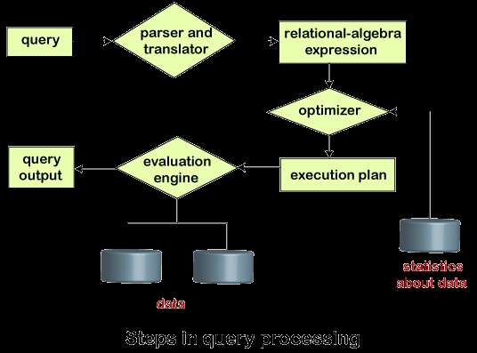
STEPS IN QUERY PROCESSING

Slide 61
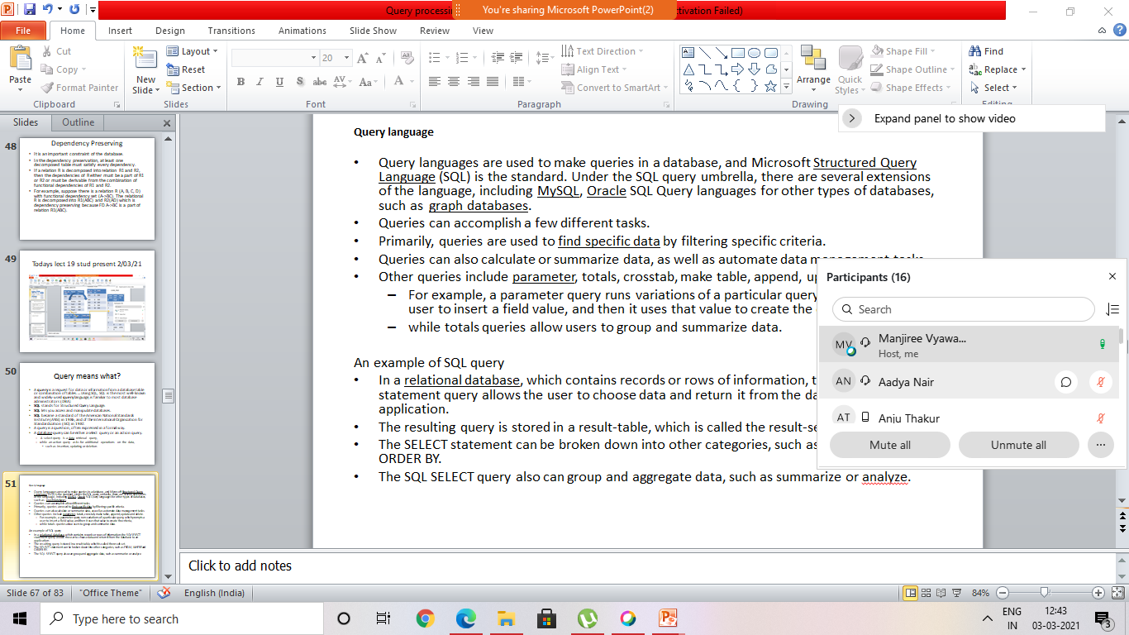
Lecter on 3/3/21 16 stud present

Slide 62
Suppose a user executes a query. As we have learned that there are various methods of extracting the data from the database.
In SQL, a user wants to fetch the records of the employees whose salary is greater than or equal to 10000. For doing this, the following query is undertaken:
select emp_name from Employee where salary>10000;
Thus, to make the system understand the user query, it needs to be translated in the form of relational algebra. We can bring this query in the relational algebra form as:
σ_{salary>10000} (π_{salary} (Employee))
π_{salary} (σ_{salary>10000} (Employee))
After translating the given query, we can execute each relational algebra operation by using different algorithms. So, in this way, a query processing begins its working.

Slide 63
Evaluation
For this, with addition to the relational algebra translation, it is required to annotate the translated relational algebra expression with the instructions used for specifying and evaluating each operation. Thus, after translating the user query, the system executes a query evaluation plan.
Query Evaluation Plan
In order to fully evaluate a query, the system needs to construct a query evaluation plan.
The annotations in the evaluation plan may refer to the algorithms to be used for the particular index or the specific operations.
Such relational algebra with annotations is referred to as Evaluation Primitives. The evaluation primitives carry the instructions needed for the evaluation of the operation.
Thus, a query evaluation plan defines a sequence of primitive operations used for evaluating a query. The query evaluation plan is also referred to as the query execution plan.
A query execution engine is responsible for generating the output of the given query. It takes the query execution plan, executes it, and finally makes the output for the user query.

Slide 64
Optimization
The cost of the query evaluation can vary for different types of queries. Although the system is responsible for constructing the evaluation plan, the user does need not to write their query efficiently.
Usually, a database system generates an efficient query evaluation plan, which minimizes its cost. This type of task performed by the database system and is known as Query Optimization.
For optimizing a query, the query optimizer should have an estimated cost analysis of each operation. It is because the overall operation cost depends on the memory allocations to several operations, execution costs, and so on.
Finally, after selecting an evaluation plan, the system evaluates the query and produces the output of the query.

Slide 65
Estimating Query Cost
Once we understood about Query processing steps and evaluation plan.
A system can create multiple plans for a query, the chosen method should be the best of all.
It can be done by comparing each possible plan in terms of their estimated cost.
For calculating the net estimated cost of any plan, the cost of each operation within a plan should be determined and combined to get the net estimated cost of the query evaluation plan.
The cost estimation of a query evaluation plan is calculated in terms of various resources that include:
Number of disk accesses
Execution time taken by the CPU to execute a query
Communication costs in distributed or parallel database systems.

Slide 66
To estimate the cost of a query evaluation plan, we use the number of blocks transferred from the disk, and the number of disks seeks.
Suppose the disk has an average block access time of t_{s} seconds and takes an average of t_{T} seconds to transfer x data blocks.
The block access time is the sum of disk seeks time and rotational latency. It performs S seeks than the time taken will be b*t_{T} + S*t_{S} seconds.
If t_{T}=0.1 ms, t_{S} =4 ms, the block size is 4 KB, and its transfer rate is 40 MB per second. With this, we can easily calculate the estimated cost of the given query evaluation plan.
Generally, for estimating the cost, we consider the worst case that could happen.
The users assume that initially, the data is read from the disk only. But there must be a chance that the information is already present in the main memory.
However, the users usually ignore this effect, and due to this, the actual cost of execution comes out less than the estimated value.
The response time, i.e., the time required to execute the plan, could be used for estimating the cost of the query evaluation plan.
But due to the following reasons, it becomes difficult to calculate the response time without actually executing the query evaluation plan:

Slide 67
When the query begins its execution, the response time becomes dependent on the contents stored in the buffer.
But this information is difficult to retrieve when the query is in optimized mode, or it is not available also.
When a system with multiple disks is present, the response time depends on an interrogation that in "what way accesses are distributed among the disks?".
It is difficult to estimate without having detailed knowledge of the data layout present over the disk.
Consequently, instead of minimizing the response time for any query evaluation plan, the optimizers finds it better to reduce the total resource consumption of the query plan.
Thus to estimate the cost of a query evaluation plan, it is good to minimize the resources used for accessing the disk or use of the extra resources.

Slide 68
The term optimization is actually a misnomer( Wrong def) because in some cases the chosen execution plan is not the optimal (or absolute best) strategy—it is just a reasonably efficient strategy for executing the query.
Finding the optimal strategy is usually too time-consuming—except for the simplest of queries.
In addition, trying to find the optimal query execution strategy may require detailed information on how the files are implemented and even on the contents of the files—information that may not be fully available in the DBMS catalog.
Hence, planning of a good execution strategy may be a more accurate description than query optimization.

Slide 69
planning of a good execution strategy
may be a more accurate description than query optimization.
As the availability of data in dbms
Finding the optimal strategy is usually too time-consuming

Slide 70
the programmer must choose the query execution strategy while writing a database program.
If a DBMS provides only a navigational language, there is limited need or opportunity for extensive query optimization by the DBMS;
instead, the programmer is given the capability to choose the query execution strategy.
On the other hand, a high-level query language—
such as SQL for relational DBMSs (RDBMSs) for object DBMSs (ODBMSs)—is more declarative in nature
because it specifies what the intended results of the query are,
rather than identifying the details of how the result should be obtained.
Query optimization is thus necessary for queries that are specified in a high-level query language.
We will concentrate on describing query optimization in the context of an RDBMS because many of the techniques we describe have also been adapted for other types

Slide 71
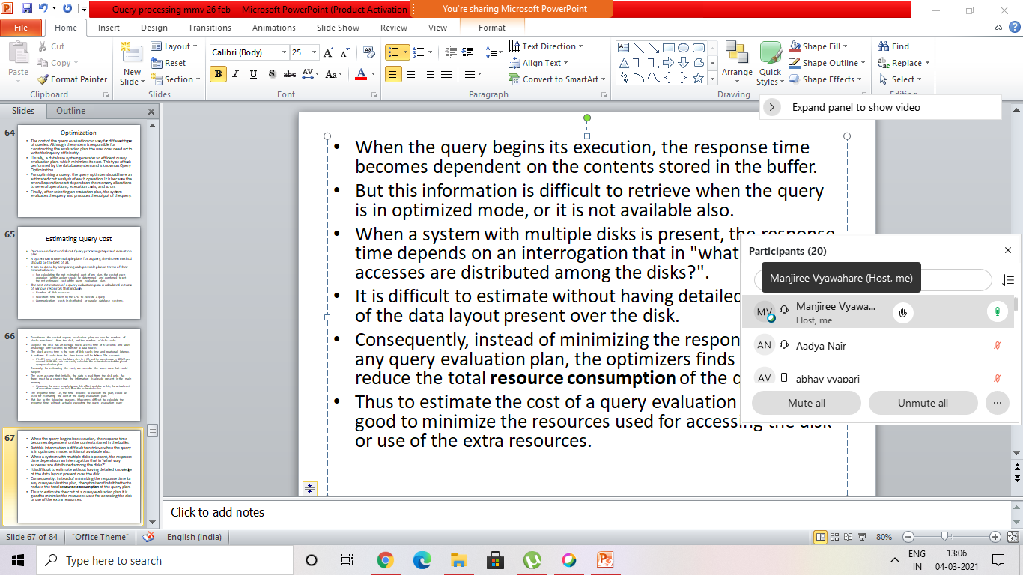
20 stud present 4/3/21

Slide 72
Each DBMS typically has a number of general database access algorithms that implement relational algebra operations such as
SELECT or JOIN or combinations of these operations.
Only execution strategies that can be implemented by the DBMS access algorithms and that apply to the particular query, as well as to the particular physical database design, can be considered by the query optimization module.

Slide 73
starts with a general discussion of how SQL queries are typically translated into relational algebra queries and then optimized
Then we discuss algorithms for implementing relational algebra operations

Slide 74
Techniques are usually combined in a query optimizer.
There are two main techniques that are employed during query optimization.
The first technique is based on heuristic rules for ordering the operations in a query execution strategy.
A heuristic is a rule that works well in most cases but is not guaranteed to work well in every case.
The rules typically reorder the operations in a query tree.
2. The second technique involves systematically estimating the cost of different execution strategies and choosing the execution plan with the lowest cost estimate.
These techniques are usually combined in a query optimizer.
Notes:
heuristic =anumanit= anuwanshik

Slide 75
example
Consider the following SQL query on the EMPLOYEE relation
SELECT Lname, Fname FROM EMPLOYEE WHERE Salary > ( SELECT MAX (Salary) FROM EMPLOYEE WHERE Dno=5 );
This query retrieves the names of employees (from any department in the company)
who earn a salary that is greater than the highest salary in department 5. The
query includes a nested sub query and hence would be decomposed into two blocks.

Slide 76
The inner block is:
( SELECT MAX (Salary) FROM EMPLOYEE WHERE Dno=5 )
This retrieves the highest salary in department 5. The outer query block is:
SELECT Lname, Fname FROM EMPLOYEE WHERE Salary > c
where c represents the result returned from the inner block. The inner block could be translated into the following extended relational algebra expression:

Slide 77
ℑMAX Salary(σDno=5(EMPLOYEE))
and the outer block into the expression:
Πlname,Fname(σSalary>c(EMPLOYEE))
The query optimizer would then choose an execution plan for each query block.
Notice that in the above example, the inner block needs to be evaluated only once to produce the maximum salary of employees in department 5,
which is then used—as the constant c—by the outer block. We called this a nested query (without correlation with the outer query) in Section 5.1.2.
It is much harder to optimize the more complex correlated nested queries (see Section 5.1.3), where a tuple variable from the outer query block appears in the WHERE-clause of the inner query block.

Slide 78
Algorithms for External Sorting
Sorting is one of the primary algorithms used in query processing.
For example,
whenever an SQL query specifies an ORDER BY-clause, the query result must be sorted.
Sorting is also a key component in sort-merge algorithms used for JOIN and other operations (such as UNION and INTERSECTION), and in duplicate elimination
algorithms for the PROJECT operation
(when an SQL query specifies the DISTINCT option in the SELECT clause )

Slide 79
External sorting refers to sorting algorithms that are suitable for large files of records stored on disk that do not fit entirely in main memory, such as most database file
The typical external sorting algorithm uses a sort-merge strategy,
which starts by sorting small subfiles—called runs—of the main file and then merges the sorted runs,
creating larger sorted sub files that are merged in turn.
The sort-merge algorithm, like other database algorithms, requires buffer space in main memory
where the actual sorting and merging of the runs is performed
( sorting two phases and merging two phases –total 4 phases are required in this sort )
Total memory cache and memory space is required ..total space required

Slide 80
sorting phase
In the sorting phase, runs (portions or pieces) of the file that can fit in the available buffer space are read into main memory, sorted using an internal sorting algorithm, and written back to disk as temporary sorted subfiles (or runs).
The size of each run and the number of initial runs (nR) are dictated by the number of file blocks (b) and the available buffer space (nB).
For example, if the number of available main memory buffers nB = 5 disk blocks and the size of the file b = 1024 disk blocks, then
nR= ⎡(b/nB)⎤ or 205 initial runs each of size 5 blocks (except the last run which will have only 4 blocks).
Hence, after the sorting phase, 205 sorted runs (or 205 sorted subfiles of the original file) are stored as temporary subfiles on disk.
( pg no 685 Algorithm is available in book for this external sorting)

Slide 81
Implementing the SELECT Operation
There are many algorithms for executing a SELECT operation, which is basically a search operation to locate the records in a disk file that satisfy a certain condition.
Some of the search algorithms depend on the file having specific access paths, and they may apply only to certain types of selection conditions.
We discuss some of the
algorithms for implementing SELECT in this section. We will use the following operations, specified on the relational database

Slide 82
OP1: σSsn = ‘123456789’ (EMPLOYEE)
OP2: σDnumber > 5 (DEPARTMENT)
OP3: σDno = 5 (EMPLOYEE)
OP4: σDno = 5 AND Salary > 30000 AND Sex = ‘F’ (EMPLOYEE)
OP5: σEssn=‘123456789’ AND Pno =10(WORKS_ON)

Slide 83
Search Methods for Simple Selection.
A number of search algorithms are possible for selecting records from a file. These are also known as file scans, because they scan the records of a file to search for and retrieve records that satisfy a selection
condition.
If the search algorithm involves the use of an index, the index search is called an index scan.
The following search methods (S1 through S6) are
examples of some of the search algorithms that can be used to implement a select operation:

Slide 84
merging phase,
In the merging phase, the sorted runs are merged during one or more merge passes. Each merge pass can have one or more merge steps.
The degree of merging dM) is the number of sorted subfiles that can be merged in each merge step.
During each merge step, one buffer block is needed to hold one disk block from each of the sorted subfiles being merged, and one additional buffer is needed for containing one disk block of the merge result, which will produce a larger sorted file that is the result of merging several smaller sorted subfiles.
Hence, dM is the smaller of (nB − 1)
and nR, and the number of merge passes is ⎡(logdM(nR))⎤.
In our example where nB = 5, dM = 4 (four-way merging), so the 205 initial sorted runs would be merged 4 at a time in each step into 52 larger sorted subfiles at the end of the first merge pass.

Slide 85
These 52 sorted files are then merged 4 at a time into 13 sorted files,
which are then merged into 4 sorted files, and then finally into 1 fully sorted file, which means that four passes are needed.

Slide 86
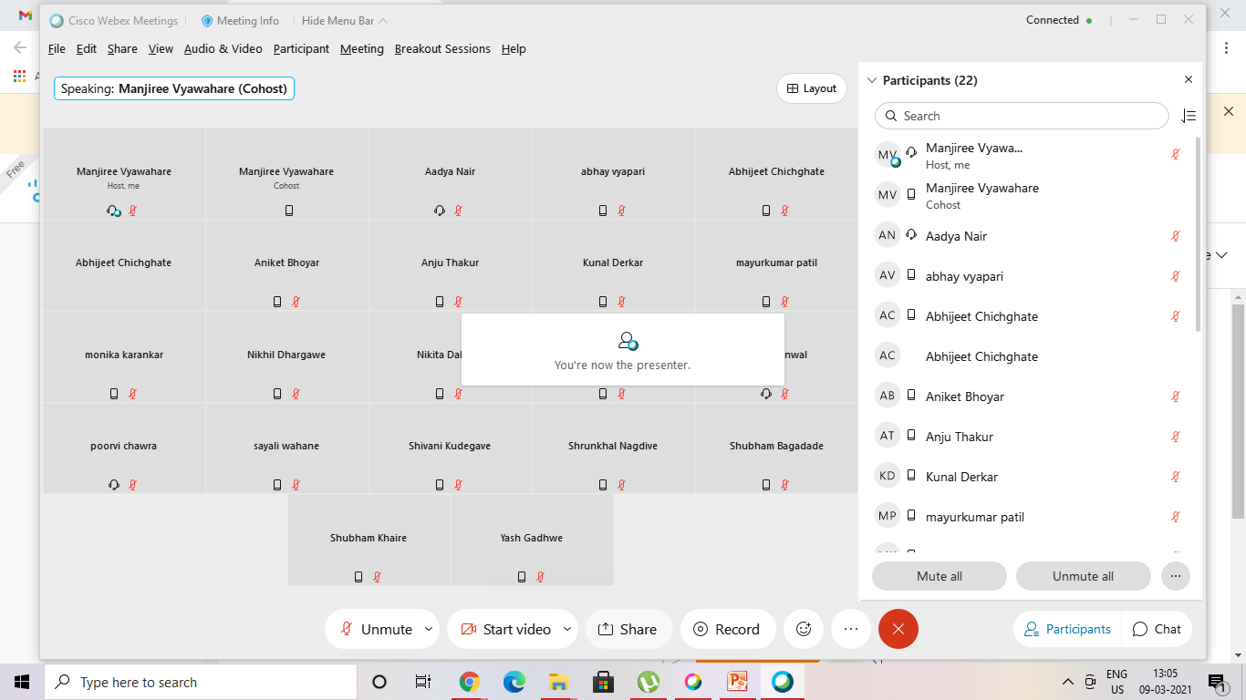
9/03/21 2 students present

